Slide 1
Extended Response
Lesson 1, Part 1
GED® Exam
ELA Lines of Inquiry

Slide 2

Learning Goals
Know what to expect on the GED® extended response.
Summarize an author’s argument.
Identify evidence from arguments.
Determine validity of evidence.

Slide 3
Your Background Knowledge
What is evidence?
Dogs are better pets than cats. Is it evidence?
75% of dog owners say that they like dogs better than cats.
Is it evidence?
Can be statistics/data, emotional appeals, logical reasoning, facts, or examples/anecdotes. Evidence is what authors write about which supports their claim. Evidence can prove or disprove a claim.
No
Yes
Notes:
What is evidence?
The GED® defines evidence as that which tends to prove or disprove something; grounds for belief.
Grounds for belief is an idiom that means a basis for belief.
Every well-constructed argument includes multiple types of evidence.

Slide 4
Your Background Knowledge (cont’d)
What do you already know about the GED® extended response (essay)?
Notes:
Ask students what they already know about the GED® extended response.

Slide 5
Extended Response
Lesson 1, Part 1
GED® Extended Response Guidelines and Scoring
ELA Lines of Inquiry

Slide 6
The Extended Response (Essay) GED® Test
GED®
HiSET®
Reading and writing tests are combined.
Multiple choice, drop down, fill in the blank, and other question formats
Extended response (essay)
  45 minutes for essay
  Score rolled into total points
  20% of total RLA score
Writing test
Multiple-choice questions
Extended response (essay)
  50 minutes
  Need a score of 2/6
Notes:
(It is helpful to talk about both tests at this point in case students are unsure which test they want to take. Also, a lot of students often don’t know there HiSET® is an alternate test for getting the Commonwealth Secondary School Diploma. Some students will opt to take the HiSET® because the reading and writing tests are split and can be taken separately.)
Explain that the extended response is just another way to say essay.
The extended essay is a part of the GED® RLA exam. The RLA exam includes three parts including, a multiple choice reading test, a multiple choice writing test, and the extended essay. After the multiple select reading and writing tests is the extended essay. The score for GED®’s extended essay is rolled into the total RLA score, and it makes up 20% of the total score. Students are given 45 minutes to write the extended response.
The extended essay is a part of the HiSET®’s writing test. The HiSET® writing test is made up of multiple-choice questions and the extended essay. Students are given 50 minutes for the extended essay portion of the HiSET® writing test. Students need a score of 2/6 to pass the extended essay.
If students question why they’re given 5 more minutes on the HiSET®, it is likely because the HiSET® writing prompt has the same requirements as the GED® except it also asks students to include information from their own knowledge and experience on the topic. GED® test takers are NOT asked to include this information.

Slide 7
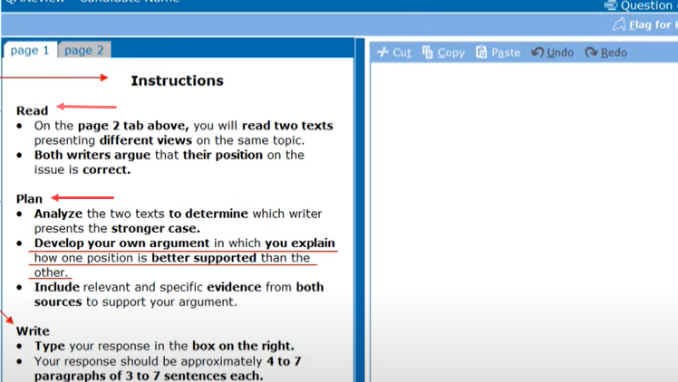
The Extended Response GED® Test
Notes:
This is a snapshot of what the students will see on the extended response portion of the GED® test. The video shows more details.
Watch this video: https://www.youtube.com/watch?v=YQbqBJYaTyI

Slide 8
Guidelines for the GED® Extended Response
45 minutes, but learn the process first.
  Typing skills are important.
4 to 7 paragraphs (3 to 7 sentences each).
Determine which position presented in the passage(s) is better supported by evidence from the passage(s).
Explain why the position you chose is the better supported one.
Notes:
Explain that students are given 45 minutes on test day to write their extended response. For now, they should get the process down, and then worry about how much they can do in 45 minutes. The time limit is just something to keep in mind at first. The time limit makes it important to practice typing skills.
GED® guidelines say that students should write 4 to 7 paragraphs. In this lesson, teacher will show an effective way to respond using 4 to 5 paragraphs.
This is a helpful supplement for teachers. Could also share link or handout with students: https://ged.com/wp-content/uploads/extended_response_guidelines.pdf.

Slide 9
Guidelines for the GED® Extended Response (cont’d)
Remember, the better supported position is not necessarily the position with which you personally agree. Must ONLY use the evidence presented in the articles.
Defend your decision with multiple pieces of evidence from the passage(s).
Build your main points thoroughly.
Make sure your points are well organized and in logical order.

Slide 10
How the GED® Extended Response is Scored
Responses will be scored based on three dimensions:
Trait 1: Creation of arguments and use of evidence.
Trait 2: Development of ideas and structure.
Trait 3: Clarity and command of standard English conventions.
Notes:
Rubric for HiSET®: https://hiset.org/s/pdf/Writing-Response-Scoring-Guide.pdf (a score of 2/6 is needed to pass the essay portion of the writing test).

Slide 11
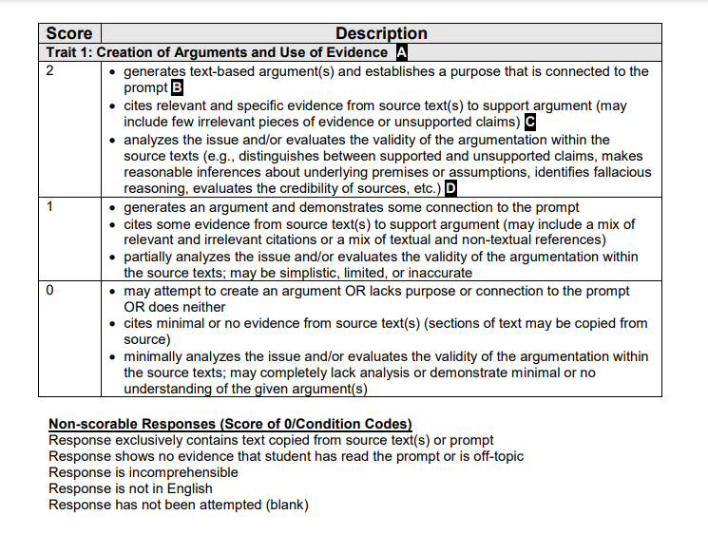
Extended Response Rubric – Trait 1: Creation of Arguments and Use of Evidence
Trait 1 – Target (2)
Develops an argument connected to the prompt.
Cites relevant evidence from texts.
Evaluates the validity of both arguments.
Notes:
Emphasize that it is very important to stay on task. If you do what the writing prompt is asking, you should get 2/2 points for trait #1. You will learn strategies to develop an argument connected to the prompt, cite relevant evidence from the text, and evaluate the validity of both arguments.
Full rubric with explanations: https://ged.com/wp-content/uploads/Annotated-Rubric_-English.pdf
A Trait 1: Responses are scored according to the criteria outlined in all three bullets. Each bullet represents a distinct dimension or quality of writing that involves the creation of arguments and use of evidence. Each score point describes the same dimensions, but at varying levels of mastery. Responses may exhibit qualities indicative of more than one score point. For instance, a response may contain a logical text based argument and sufficient support (a 4-point response), but the integration of claims might be simplistic (a 2-point response). When a response shows mixed evidence of proficiency levels, it will receive a score that reflects a balanced consideration of each quality, with no one dimension weighted more than the others.
B The first dimension relates to making claims or assertions. At higher score points, arguments will be focused on close reading and analysis of the source texts. As responses ascend the scale in this dimension, they will become more focused on making arguments.
C The second dimension focuses on a student’s ability to use information from the source texts to support their claims or assertions. As responses ascend the scale in this dimension, they will use evidence that is progressively more tied to the text. At lower score points, the student may rely more heavily on evidence drawn from personal experience with the topic rather then from text-based evidence. While responses that argue the student’s own opinion on the issue are acceptable, students who focus more specifically on the task outlined in the prompt, which asks them to analyze source texts to determine which position is better supported, will be more likely to score highly on this dimension. More specifically, responses that establish criteria for the evaluation of the source texts and then apply these criteria to specific text-based evidence are most likely to score highest in this dimension.
D The third dimension focuses on a student’s ability to critically evaluate the rhetorical strategies and argumentation demonstrated by the authors of the source texts. While responses that argue the student’s own opinion on the issue are acceptable, students who focus more specifically on the task outlined in the prompt, which asks them to analyze source texts to determine which position is better supported, will be more likely to score highly on this dimension. More specifically, responses that establish criteria for the evaluation of the source texts and then apply these criteria to specific text-based evidence are most likely to score highest in this dimension.

Slide 12
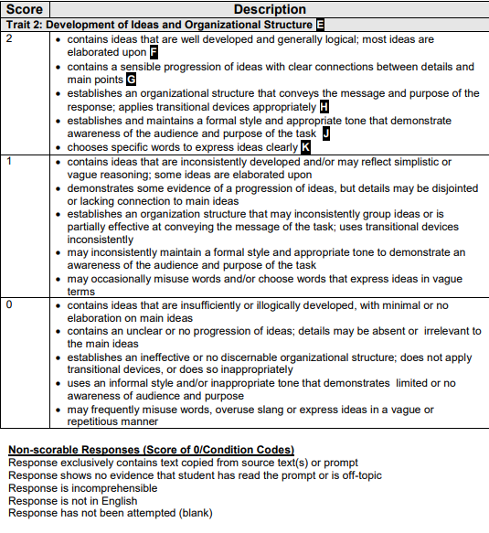
Extended Response Rubric – Trait 2: Development of Ideas and Organizational Structure
Trait 2 – Target (2)
Provides fully developed ideas.
Establishes an organizational structure. Uses transitions.
Makes clear connections between main point and details.
Maintains a formal tone and awareness of audience.
Expresses ideas clearly.
Notes:
Full rubric with explanations: https://ged.com/wp-content/uploads/Annotated-Rubric_-English.pdf
E. The five bullets, or dimensions, in Trait 2 must be considered together to determine the score of any individual response. No one dimension is weighted more than any other. Each score point describes the same dimensions, but at varying levels of mastery.
F. The first dimension relates to the depth and breadth of explanation exhibited in the response. While support for ideas should come from the source texts (like in Trait 1), fully developed ideas are often extended with additional evidence that builds upon central assertions. High-scoring papers will tend to contain multiple ideas that are fully elaborated upon and help articulate a central thesis. Responses that develop ideas insufficiently, unevenly, or illogically fall into the lower score ranges with regard to this dimension.
G. The second dimension focuses on how effectively the response builds from one idea to the next as well as the degree in which details and central ideas are linked. High-scoring responses will maintain coherence and a sense of progression that help convey the writer’s central thesis. Responses at lower score points demonstrate an increasingly disjointed or unclear progression of ideas. Details are increasingly unrelated to central ideas, or even absent.
H. The third dimension relates to how well the response is organized. Though paragraphs may lend structure to many responses, it is possible for a well organized, logical, non-paragraphed response to receive a high score. However, responses that contain circular, list-like, or scattered organizational structure, as well as those that do not fully integrate effective transitions between ideas, are often indicative of lower score points.
J. The fourth dimension is associated with how well the response demonstrates an understanding of audience and purpose. Responses that score highly in this dimension will establish and maintain a formal style and objective tone while attending to the norms and conventions of argumentative writing.
K. The fifth dimension focuses on word choice. Effective word choice does not necessarily suggest that students must employ a great deal of advanced vocabulary. Advanced vocabulary used correctly is often associated with a higher score on Trait 2, but responses that reflect a precision in word choice are just as likely to score well in this dimension. At lower score points, imprecise, vague and/or misused words are more prevalent.

Slide 13
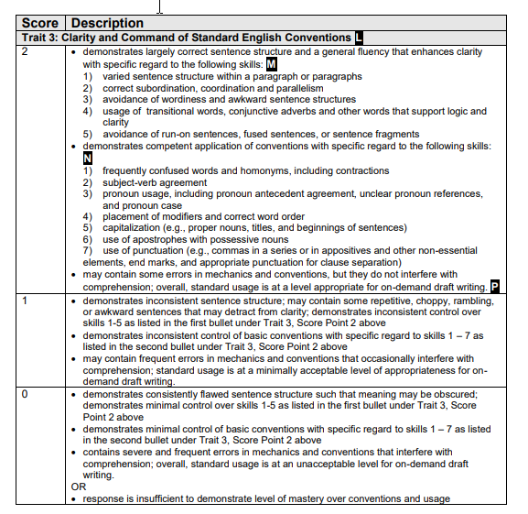
Extended Response Rubric – Trait 3: Clarity and Command of Standard English Conventions
Trait 3 – Target (2)
Uses correct and varied sentence structure that provides a level of fluency in the response.
Demonstrates competency of conventions.
Limits errors in mechanics and usage by editing.
Notes:
Highlight that you can make grammatical errors and still get 2 points. It’s understood that this is a timed test, so some errors are inevitable. This is also why it is so important to proofread and edit your work to make sure you catch any typos.
Full rubric with explanations: https://ged.com/wp-content/uploads/Annotated-Rubric_-English.pdf
L As in the previous two traits, each of the three dimensions of Trait 3 must be weighed together to determine the score. Each score point describes the same dimensions, but at varying levels of mastery.
M This dimension relates to sentence structure and variety. Scoring will focus only on these skills essential to the development of sentence structure. High-scoring responses mix simple and compound sentences and purposefully incorporate a variety of clauses to enhance overall fluidity. Repetitive, choppy, rambling, and/or awkward sentence constructions are indicative of responses at the lower score points.
N The second dimension focuses on how well the response maintains specific conventions of standard English. Responses will be scored on the basis of a student’s demonstrated mastery over the particular language skills listed in this dimension. Though there are many other conventions that come into play in a student’s writing, these essential skills are the ones on which they will be scored. Further, the longer the response, the greater tolerance for errors. For example, 10 errors in a 10-line response will likely receive a lower score than a response that contains 20 errors but is 60 lines long.
P The third dimension pertains to overall fluency with conventions and mechanics. In order to receive a score higher than 1, students must sustain their writing long enough to demonstrate their level of proficiency with all the skills listed in the two previous dimensions. Then, writing samples are evaluated for level of grammatical and syntactical fluency appropriate for on-demand, draft writing.

Slide 14
Discussion
45
How many minutes do you have to write the extended response?
What percentage of the Reasoning Through Language Arts test score is the extended response?
What will you be asked to write about for the extended response?
What are the three traits on the rubric for scoring the extended response?
20%
About the prompt. Determine which argument is better supported with the evidence provided.
Creation of Arguments and Use of Evidence; Development of Ideas and Organizational Structure; Spelling, Grammar, and Sentence Structure
Notes:
Ask students:
How many minutes do you have to write the extended response? (45 mins)
What percentage of the Reasoning with Language Arts test score is the extended response? (20%)
What will you be asked to write about for the extended response? (Determine which argument is better supported with the evidence provided)
What are the three traits on the rubric for scoring the extended response? (Trait 1: Creation of arguments and use of evidence, Trait 2: Development of ideas and structure, Trait 3: Clarity and command of standard English conventions.)
Ask students: “What questions do you have about the expectations, guidelines, and scoring for the extended response test?”

Slide 15
Review of Guidelines and Scoring for Extended Response #1
How long do you have to write your extended response?
30 minutes
45 minutes
55 minutes
60 minutes
90 minutes
Notes:
Answer B

Slide 16
Review of Guidelines and Scoring for Extended Response #2
What percentage of your total score on the Reasoning Through Language Arts exam is the extended essay?
10%
15%
20%
35%
50%
Notes:
Answer C

Slide 17
Review of Guidelines and Scoring for Extended Response #3
How many paragraphs should you write for your extended essay?
1 to 3
2 to 3
2 to 4
3 to 5
4 to 7
Notes:
Answer E

Slide 18
Review of Guidelines and Scoring for Extended Response #4
Which of the following are guidelines for the extended essay? (There are three correct choices.)
Determine which argument is best supported.
State your opinion.
Use multiple pieces of evidence from the passages.
Organize your points in a logical way.
Write about an argument of your choice.
Notes:
Answers A, C, and D
Reinforce that for the GED®, students must determine which argument is best supported based on evidence provided in the passage(s).
This is where the HiSET® test differs. On the HiSET® test students are asked to include their own knowledge and experience about the topic as well as evidence from the passage(s).

Slide 19
Review of Guidelines and Scoring for Extended Response #5
How many traits are on the extended response rubric?
1
2
3
4
5
Notes:
Answer C

Slide 20
Review of Guidelines and Scoring for Extended Response #6
Which of the following are traits on the extended response rubric? (There are three correct choices.)
Creation of argument and use of evidence (staying on task for what the prompt asks you to do)
Cites relevant and specific evidence from the passage
Development of ideas and organizational structure (using paragraphs, setting them up as an introduction, 2-3 body paragraphs, and a conclusion, using transitions)
Clarity and command of standard English conventions (correct spelling and grammar, varied sentence structure)
Clear ideas that are logically presented
Notes:
Answers A, C and D

Slide 21
Extended Response
Lesson 1, Part 2
GED® Exam
ELA Lines of Inquiry

Slide 22
Using a Four-Step Process to Complete the Essay
Reading
Organize Evidence
Writing
Proofreading & Editing
Notes:
Approach the extended essay with a four-step process.
Reading (the titles of the passage(s), writing prompt and the passage(s)
Organize evidence
Writing
Proofreading and editing

Slide 23
Step 1: Closely Read the Prompt and Passage(s)
Reading
Organize Evidence
Writing
Proofreading & Editing
Notes:
First, we will work through step one, reading the title of the passage(s), writing prompt, and passage. The writing prompt describes what you’re supposed to write about and the passage you read will present an argument.

Slide 24
Step 1: Closely Read the Title, Writing Prompt, and Passage(s)
An argument will be presented in one or two passages.
Read the title of the passage to give you an idea of what it is about. Read both titles if there are two passages.
We do not know the topic of the argument, but we do know that this will be a part of the writing prompt.
Analyze the arguments presented in the two articles. In your response, develop an argument in which you explain how one position is better supported than the other. Incorporate relevant and specific evidence from both sources to support your argument. Remember, the better-argued position is not necessarily the position with which you agree. This task should take approximately 45 minutes to complete.
Notes:
The first task in the four step process is closely reading the writing prompt and passage(s) presenting the argument. Sometimes an argument is presented in one passage, while other times, the argument is presented in two passages.

Slide 25
Read and Analyze the Writing Prompt
Question: What does the prompt ask us to do?
As you read, identify the verbs (action) in the prompt and what the verbs ask us to do.
Directions: Read the writing prompt.
First, read it to yourself
Then, we will read it together.
The goal is to be able to unpack the prompt prior to reading the passage. This will let you know what you will need to write about and help you comprehend the passage by telling you what it is about.
Notes:
Show extended response prompt example.
Optional texts:
1. New Readers Press Fracking Articles
2. GED® Sample Extended Response Passages.
You’ll need one text for the instructional and practice parts of this lesson and another for the summative assessment.
For students taking the HiSET®
Instructors can use one of the above referenced example passages, but the prompt must be updated. The prompt for the HiSET® must read, “Below you will find two passages in which the authors put forth differing perspectives on an issue of importance. Read both passages carefully, noting the strengths and weaknesses of each discussion. Then, you will write an essay in which you explain your own opinion on the issue. Be sure to use evidence from the text passages provided as well as specific reasons and examples from your own experience and knowledge to support your position.” It is also likely they’ll see this in a separate paragraph, “Remember that every position exists within the context of a larger discussion of the issue, so your essay should, at minimum, acknowledge alternate and/or opposing ideas. When you have finished your essay, review your writing to check for correct spelling, punctuation and grammar.” The main difference between the GED® and HiSET® essay is the prompt. GED® test takers are asked to analyze the facts presented only, while HISET® test takers are asked to analyze the facts presented but also to include their knowledge and experience on the topic.”
Remember that when teaching each of these strategies, you will want to first model for your students each routine and then have them practice the routine with you until they are able to complete the task independently.
Review the steps on the slide.

Slide 26
Unpacking the Prompt
Analyze the arguments presented.
In your response, develop an argument in which you explain how one position is better supported than the other. Incorporate relevant and specific evidence from both sources to support your argument.
Remember, the better-argued position is not necessarily the position with which you agree. This task should take approximately 45 minutes to complete. Your response should contain 4-7 paragraphs of 3-7 sentences each, about 300-500 words.
Do | What
Analyze | Arguments presented in texts
Develop | Argument
Explain | How one position is better supported
Incorporate | Relevant and specific evidence from both sources
Take | About 45 minutes
Notes:
It is important that students understand the concept of analyzing a prompt. One routine is to use Do/What to unpack a prompt.

Slide 27
Organizing the GED® Extended Response (Essay) Worksheet
Use this worksheet as a guide to organize evidence that you will use to write your extended response (essay) to respond to the following writing prompt.
There are five sections on the worksheet that you will complete as we work through this lesson.
Now, let’s work on Part 1, evaluating the passage together.
Notes:
Give each student a copy of the Organizing the GED® Extended Response Worksheet: https://docs.google.com/document/d/1u0Rz4OgHk6CiEC9Udi-j770KYTuvuvydVhmyovLDd6k/copy

Slide 28
Guided Practice: Organizing the GED® Extended Response (Essay) Worksheet Part 1, Passage 1
Directions: We will read the first passage together and then answer these questions on Part 1 of the worksheet for Passage 1. First, let’s review the questions before we read the first passage.
What is the author’s main argument? Use your own words to summarize the main idea.
What position does the author take (for or against)?
What is one piece of evidence presented to support the author’s argument? What is the source of the information? Is the source reliable?
What is a second piece of evidence presented to support the author’s argument? What is the source of the information? Is the source reliable?
What is a third piece of evidence presented to support the author’s argument? What is the source of the information? Is the source reliable?
What are the major underlying assumptions that the author makes? Do you think they are reasonable and acceptable to most people?
Notes:
As we read the first passage together, you will want to think about these questions (go through these questions with students). Then we will answer the questions on part #1 of your Organizing the Extended Response worksheet for passage 1.

Slide 29
Independent Practice: Organizing the GED® Extended Response (Essay) Worksheet Part 1, Passage 2
Directions: You will read the second passage on your own and then answer the questions on Part 1 of the graphic organizer for Passage 2 with a partner. Then, we will review the questions together.
What is the author’s main argument? Use your own words to summarize the main idea.
What position does the author take (for or against)?
What is one piece of evidence presented to support the author’s argument? What is the source of the information? Is the source reliable?
What is a second piece of evidence presented to support the author’s argument? What is the source of the information? Is the source reliable?
What is a third piece of evidence presented to support the author’s argument? What is the source of the information? Is the source reliable?
What are the major underlying assumptions that the author makes? Do you think they are reasonable and acceptable to most people?
Notes:
Now you will read passage 2 on your own. As you read, think about these questions. Then you will answer part #1 of your Organizing the Extended Response worksheet for passage 2 with a partner (or small group). Reinforce that even though working in partners, every student should complete their own worksheet. After everyone is finished, we will review your responses together.
Read the first passage together and guide students through these questions as they complete part 1 of the organizing the extended response worksheet: https://docs.google.com/document/d/1u0Rz4OgHk6CiEC9Udi-j770KYTuvuvydVhmyovLDd6k/edit?usp=sharing.
Additional graphic organizers: https://ged.com/wp-content/uploads/GEDTS-Graphic-Organizers-2018-1.pdf

Slide 30
Share: Organizing the GED® Extended Response (Essay) Worksheet Part 1, Passage 2
What is the author’s main argument? Use your own words to summarize the main idea.
What position does the author take (for or against)?
What is one piece of evidence presented to support the author’s argument? What is the source of the information? Is the source reliable?
What is a second piece of evidence presented to support the author’s argument? What is the source of the information? Is the source reliable?
What is a third piece of evidence presented to support the author’s argument? What is the source of the information? Is the source reliable?
What are the major underlying assumptions that the author makes? Do you think they are reasonable and acceptable to most people?
Notes:
Go through each of these six questions and ask for volunteers from different groups to share their answers.

Slide 31
Review
Extended response is 20% of your total score on the RLA exam.
45 minutes for the extended response.
Four-step process for approaching the extended response:
Reading the writing prompt and passages
Organizing evidence (use graphic organizers to practice, highlighting tool to save time)
Writing the extended response
Proofreading and editing
What we know about the writing prompt:
                Determine which position presented in the passage(s) is better supported by evidence from the passage(s).
                Explain why the position you chose is the better supported one.

Slide 32
Review (cont’d)
Remember, the better supported position is not necessarily the position with which you personally agree. You must ONLY use the evidence presented in the articles.
Defend your decision with multiple pieces of evidence from the passage(s).
Build your main points thoroughly.
Make sure your points are well organized and in logical order.
Responses will be scored based on three dimensions:
                Trait 1: Creation of arguments and use of evidence.
                Trait 2: Development of ideas and structure.
                Trait 3: Clarity and command of standard English conventions.

Slide 33
What’s Next?
Next, we will work on organizing the evidence from both sides of the argument.
Complete Parts 2A and 2B of the Organizing the GED® Extended Response (Essay) worksheet together.

Slide 34
Additional Practice
Grammar instruction and practice from Khan Academy
Typing practice from Typing.com
Notes:
Grammar instruction and practice: https://www.khanacademy.org/humanities/grammar
Typing practice: Typing.com
If students need additional practice teachers could select another article or articles that present an argument, make a copy of the Organizing the GED® Extended Response (Essay) worksheet, and ask students to read the article and complete part 2 for both sides of the argument presented.
Additional practice prompts, passages from the GED® testing service: https://ged.com/wp-content/uploads/extended_response_classroom_practice.pdf (just ensure that you don’t assign the same prompt/passage if using one of them for the summative assessment).
Grammar instruction and practice: https://www.khanacademy.org/humanities/grammar

