Slide 1
Economics
Lesson 2
Self-Employment: Integrating Text and Tables
ELA Lines of Inquiry

Slide 2
Introduction
This week we’ll be reading about fundamental economics concepts, which are included in the Social Studies section of the GED® and HiSET® tests. In these readings, we’ll be focusing on the skills of interpreting charts, graphs, and other visually presented information. Today’s topic is self-employment, and the main skill we’ll be working on is interpreting tables of data and integrating that information with the accompanying text.

Slide 3
Lesson Objectives
By the end of the lesson, you should be able to …
Interpret data presented in a table.
Integrate that information with an accompanying text to answer comprehension questions.
Use the information from the tables and text to write one paragraph giving advice about self-employment.

Slide 4
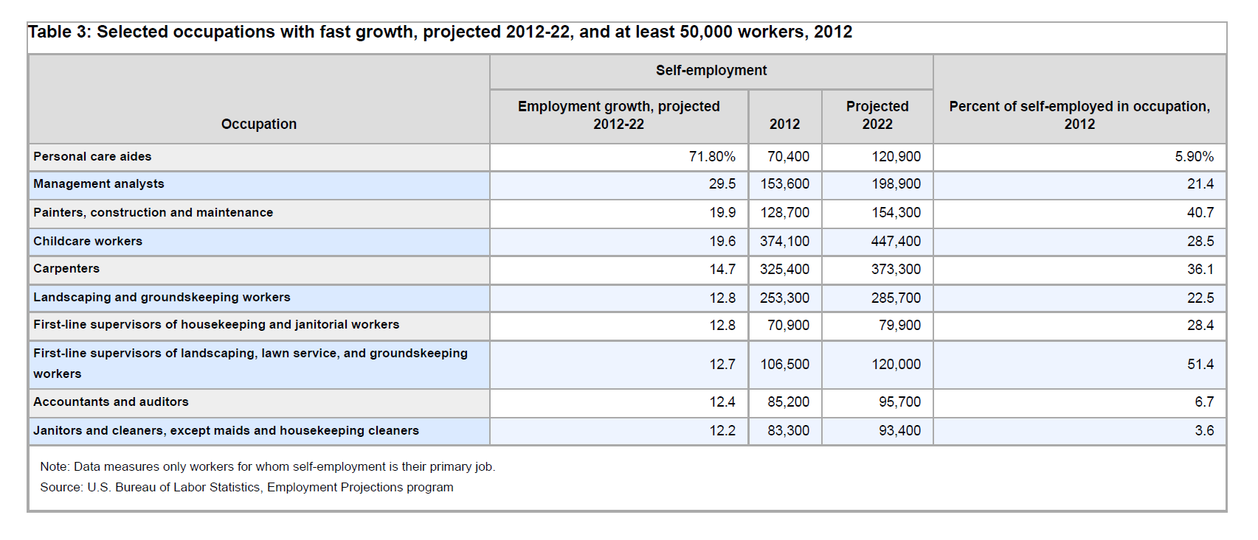
Task 1: Analyze the Information in the Table
What do you notice?
What do you wonder?

Slide 5
Task 2
Write answers to Introductory Questions for Table 3.

Slide 6
Task 3
Complete the Vocabulary Activity.
Rate your knowledge of the words.
Review definitions.
Share personal examples.
Complete sentences.

Slide 7
Task 4
Read Section 1 and answer the accompanying questions.

Slide 8
Task 5
Read Section 2 and answer the accompanying questions.
Select a member of your group to report to the whole class.

Slide 9
Task 6
Read Section 3 and answer the accompanying questions.
Be prepared to report to the whole class.

Slide 10
Task 7
Part 1: Answer the questions and be prepared to share.
Part 2: Be prepared to share your paragraph out loud.

Slide 11
Task 8: Self-Reflection
Review today’s objectives and then complete the Self-Reflection.
By the end of the lesson, you should be able to …
Interpret data presented in a table.
Integrate that information with an accompanying text to answer comprehension questions.
Use the information from the tables and text to write one paragraph giving advice about self-employment.

