Slide 1
Economics
Lesson 1
Factors of Production
ELA Lines of Inquiry

Slide 2
Introduction
What comes to mind when you hear the phrase “opening a business”?

Slide 3
Lesson Objectives
By the end of the lesson, you should be able to …
Work with partners to summarize and rewrite a paragraph of text in your words.
Identify the four factors of production and examples of each.
Interpret information in graphs to answer data-specific questions.

Slide 4
In Your Own Words Activity
Directions:
Using your group’s paragraph assignments, work together to rewrite your paragraph in your own words.
  a. You may look up unknown words or ask each other for help.
Select someone from your group to share your rewritten paragraph with the whole class.

Slide 5
In Your Own Words Example
Original Text: What Are the Factors of Production?
“The factors of production are resources that are the building blocks of the economy; they are what people use to produce goods and services. Economists divide the factors of production into four categories: land, labor, capital, and entrepreneurship.”
In My Own Words: What Are the Factors of Production?
The factors of production are the things that help make the economy work. They help people to make things and provide services. There are four factors of production: land (property), labor (people working), capital (tools, machines, etc.), and entrepreneurship (people starting businesses).

Slide 6
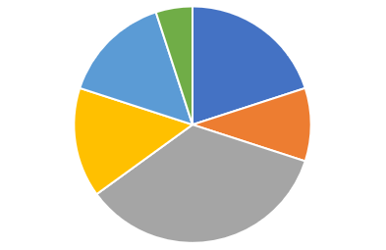
Guided Practice – Activity 1
What do you notice about this image?
What questions do you have about this image?

Slide 7
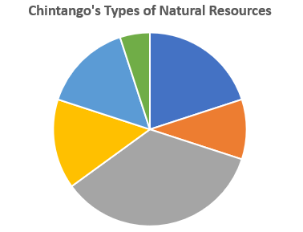
Guided Practice – Activity 1
What does the image represent?
What are natural resources?
What are some examples of natural resources or land resources that you think may be represented on this image?
Why are natural resources important to a country’s economy?

Slide 8
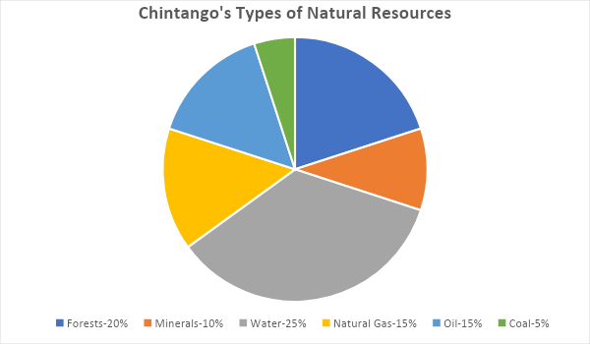
Guided Practice – Activity 1

Slide 9
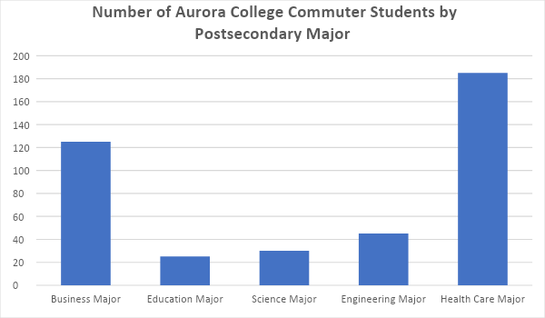
Guided Practice – Activity 2
What do you notice about this image?
What questions do you have about this image?

Slide 10
Guided Practice – Activity 2

Slide 11
Guided Practice – Activity 2

Slide 12
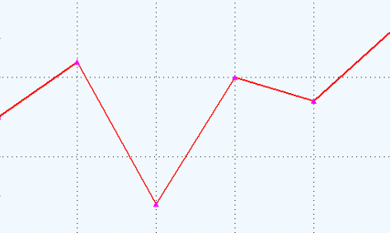
Guided Practice – Activity 3
What do you notice about this image?
What questions do you have about this image?

Slide 13
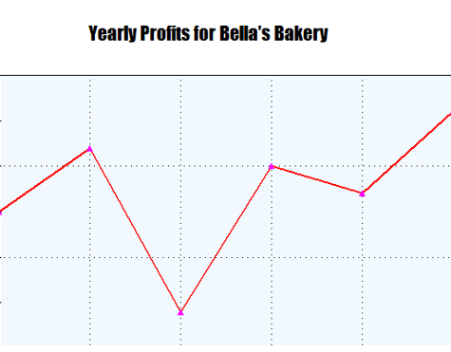
Guided Practice – Activity 3

Slide 14
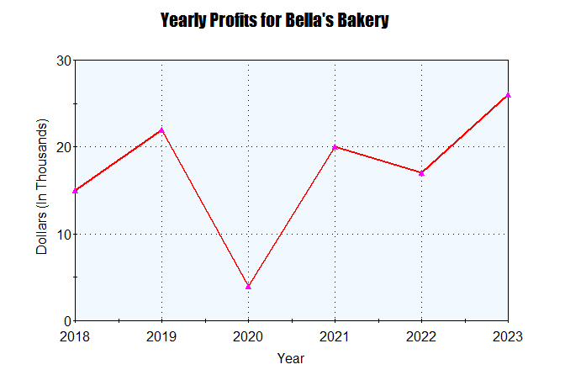
Guided Practice – Activity 3

Slide 15
Exit Ticket
Review today’s objectives and then complete the Exit Ticket.
By the end of the lesson, you should be able to …
Work with partners to summarize and rewrite a paragraph of text in your words.
Identify the four factors of production and examples of each.
Interpret information in graphs to answer data-specific questions.

