Slide 1
Natural Resources for Energy
Lesson 1
Nonrenewable and Renewable Energy
ELA Lines of Inquiry

Slide 2


Learning Goals
By the end of this lesson, you should be able to:
  Define natural resources.
  Define renewable and nonrenewable resources.
  Provide at least three examples of renewable and nonrenewable resources.
  Write an argument that supports a claim about using natural resources with valid reasoning and relevant evidence.
Listen | Watch

Slide 3

Your Background Knowledge
What does it mean for something to be natural? How do you know if something is not natural or unnatural?
Raise your hand.
Talk to the class.

Slide 4
Your Background Knowledge
What is a resource?
What resources do you use to learn? What resources do you use to get around your city or town?
Raise your hand.
Talk to the class.

Slide 5
Your Background Knowledge
Have you heard the term “natural resource” before?
In what contexts have you heard it?
Raise your hand.
Talk to the class.

Slide 6
Natural Resources
Are materials found in nature that help to support and sustain life on Earth.
Are sometimes called “raw materials.”
Are our primary sources of energy.
Listen | Watch

Slide 7
Natural Resources for Energy
Renewable:
Energy sources that either exist in a limitless quantity or are able to be replenished as quickly as they are used by humans.
Nonrenewable:
Energy sources that are finite (not limitless) and cannot be replenished within a human lifetime.
Listen | Watch

Slide 8
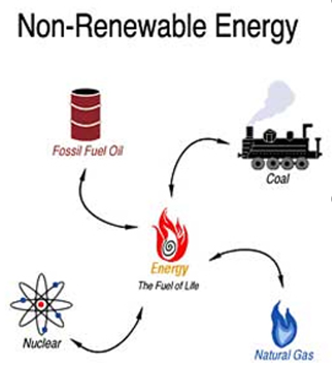
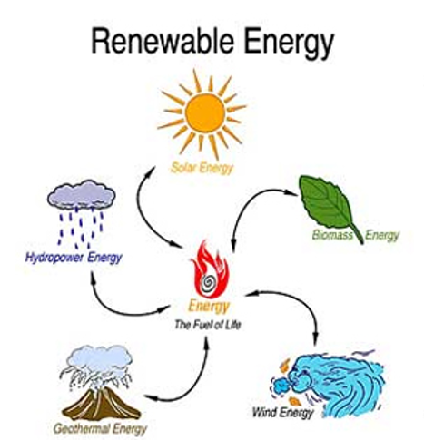
Renewable vs. Nonrenewable Energy
Video: Nonrenewable Energy
Video: Renewable Energy
Listen | Watch
Source: https://quizlet.com/42152580/energy-resources-flash-cards/
Notes:
This vide on renewables (https://www.youtube.com/watch?v=e_6reSTvrcc) is definitely AI generated, but it quickly and approachably covers each of the types of renewables in the chart.

Slide 9

Let’s Practice
Now, let’s practice using and organizing our vocabulary about renewable and nonrenewable resources.
In the top two boxes, write “Nonrenewable” on the left and “Renewable” on the right.
What two categories of nonrenewable resources might go under Nonrenewable?
Think about the types of energy we’ve learned about so far. Try to recall as many as you can and categorize them as “Renewable” or “Nonrenewable.”
Work by yourself.
Answer the questions.
Listen

Slide 10

What natural resources do we use for energy everyday?
Raise your hand.
Talk to the class.
Notes:
Suggesting we move this here, after students have been exposed to the vocab.

Slide 11





Where does the energy come from when we …
Manufacture products?
Turn on the lights?
Drive our cars?
Heat our homes?
Plant and harvest crops?
Listen | Watch
Notes:
Turn on the lights: Electricity from a power grid most likely from a thermal powerplant (coal, gas, or nuclear).
Drive our cars: Gasoline/diesel from crude oil, ethanol from corn, Evs use rechargeable batteries
Heat our homes: Natural gas, propane, or electricity from a powerplant
Plant and harvest crops: Gasoline or diesel fuel from crude oil
Manufacture products: Electricity from powerplant

Slide 12
Arguments
The GED® and HiSET® tests require you to understand how to construct and critically read arguments.
The tests expect you to write arguments with clear, well-developed claims, as well as with valid evidence.
They also expect you to read several arguments that take differing perspectives on issues and to evaluate the claims and reasoning the authors of those arguments use.
Listen | Watch

Slide 13
Did You Know?
The way the GED® and HiSET® tests use the word “argument” is different from the everyday definition of argument. When you see the word “argument” on your test, it doesn’t mean a heated or stressful disagreement between two people.
Instead, it means an author’s expression of their point of view on an issue or topic, which is supported by evidence.
Listen | Watch

Slide 14
Don’t Worry!
If this feels new to you or overwhelming, don’t worry! Over the next few lessons, you are going to have the opportunity to build your skills both reading and writing arguments while learning about the science topic of natural resources.
You will get ongoing feedback from your instructor so you can build your skills and confidence.

Slide 15
Arguments
The use of nonrenewable and renewable natural resources is a highly debated topic.
Many authors (who may also be scientists, politicians, businesspeople, concerned citizens, etc.) write arguments about how they believe natural resources should be used.
For this part of the lesson:
    We will first learn about the parts of a strong, well-supported argument.
    Next, we will look at two sides of a debate about the use of natural resources.
    Lastly, you will have the opportunity to write your own one- to two-paragraph argument about your stance on how natural resources should be used.
Listen | Watch

Slide 16
Arguments
Let’s watch a video about how to analyze an argument. It shows an example of a strong argument.
There will be a quiz after the video, so you may check your understanding.
Pay attention to the definitions of the following words:
  Argument
  Claim
  Premises
  Conclusion
  Video: Analyzing the Argument
Listen | Watch

Slide 17
Analyzing Arguments Quiz
Now, we will take a practice quiz on the video we just watched to see what we’ve learned so far about analyzing arguments.
Work independently to choose the best answers. Read the questions and answer choices closely.
Work by yourself.
Answer the questions.
Notes:
Link to Quiz: https://docs.google.com/document/d/1TLllkLlaHF9Km_02ZOZSDdsPXwr_2FqoeWrcU7nUM6w/edit?usp=sharing
Link to Answer Key: https://docs.google.com/document/d/1mRgkjMiFJZJTRitN5BsEs3cQ--pfobTttOvjZPYG0uo/edit?usp=sharing

Slide 18
What are some of the common arguments around issues with renewable energy?
Geographic limitations
Dependability
Cost effectiveness
Listen | Watch
Notes:
Instructor prompts a discussion to activate prior knowledge on some of the common issues surrounding renewable energy by asking the question on the slide and reading the phrases.
For more insight on a few of the mainstream arguments on renewables and non-renewables visit this website:
https://alternativeenergy.procon.org/top-10-pro-con-arguments/

Slide 19
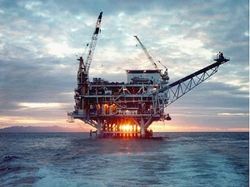
What are some of the common arguments around issues with nonrenewable energy?
Finite supply
Global warming
Environmental issues
This Photo by Unknown Author is licensed under CC BY
Listen | Watch
Notes:
We will want to include a more detailed script for teachers to read for this slide

Slide 20


Two Arguments About Renewable and
Nonrenewable Energy
Now, we will watch two videos which present different arguments about our current readiness to transition from nonrenewable to renewable energy sources. Your instructor will share a worksheet for you to complete as you watch the videos. We will work together to take notes on the evidence and main claim for Video 1. For Video 2, you will take notes on the evidence and claims independently. Then, you will use page 2 and the notes you took on page 1 to write your own argument paragraph.
Video 1: Why the U.S. isn’t ready for clean energy, from Vox
Video 2: Can 100% renewable energy power the world?, from TedEd
Ask the teacher
if you have a question.
Take notes | Listen | Watch |
Notes:
Link to worksheet: https://docs.google.com/document/d/1jT-Z5KT9BhNH7fhdGVGY-NoDECg190XmdWy7U1SvNvE/edit?usp=sharing

Slide 21

Discuss
What do you think was the main claim of each video?
What evidence supported each claim?
When your teacher asks, raise your hand and share with the class.
Talk to your partner or group.
Notes:
Formative 2.

Slide 22
Writing Your Argument Paragraph
Now, you will have the opportunity to try your hand at writing an argument paragraph.
On page 2 of your worksheet, you will find instructions, sentence starters, and a copy of the mentor paragraph found on the next slide to support you. Please also use the first page to pull your wording of evidence and claims from the video.
Ask the teacher
if you have a question.
Write | Listen | Watch |
Notes:
Summative 2: Students type/write their argument (one or two paragraphs to support the claim in the text.)
Link to prompt + worksheet (pg 2) https://docs.google.com/document/d/1jT-Z5KT9BhNH7fhdGVGY-NoDECg190XmdWy7U1SvNvE/edit?usp=sharing

Slide 23
Writing Your Argument Paragraph
What is a mentor text?
A mentor text is an example response to the prompt you are asked to write.
You should aim for your response to have a similar word count, style, grammar, and tone as the mentor text.
You should not aim to copy the ideas or the content of the mentor text. The ideas and content you write should reflect your own stance on the issue.
Mentor Text
Renewable energy is currently a good alternative to nonrenewable energy because, as the TedEd video discusses, we are making ample scientific progress toward efficiency of renewable energy sources. Evidence from the TedEd video that supports this claim is that solar energy is being converted into chemical energy in labs. The TedEd video presents stronger evidence because it shows a balanced perspective of the current limitations of renewables alongside the progress being made.
Ask the teacher
if you have a question.
Write | Listen | Watch |
Notes:
Summative 2: Students type/write their argument (one or two paragraphs to support the claim in the text.)
Link to prompt + worksheet (pg 2) https://docs.google.com/document/d/1jT-Z5KT9BhNH7fhdGVGY-NoDECg190XmdWy7U1SvNvE/edit?usp=sharing

Slide 24

Reflection
Can you:
  Define natural resources?
  Define renewable and nonrenewable resources?
  Provide at least three examples of renewable and nonrenewable resources?
  Write an argument that supports a claim about using natural resources with valid reasoning and relevant evidence?
Ask the teacher
if you have a question.
Listen | Think |

