Slide 1
Aligning Programming to the PA WIOA Combined State Plan and Local Workforce Development Area Plans
Chrissie Klinger and Loretta Lininger
Workforce Development System Liaison Project
Friday Lunchtime Webinar
November 22, 2024
Notes:
Title: Aligning Programming to the Pennsylvania Workforce Innovation and Opportunity Act Combined State Plan and Local Workforce Development Area Plans
Presenters: Chrissie Klinger and Loretta Lininger
Description: During this session, we will provide updates on activities that are happening statewide to support Pennsylvania's Combined State Plan. We will also discuss ways adult education program administrators can be involved in the development of a local workforce development area plan. Participants will have time to share challenges and opportunities and learn from one another.
Outline:
-Share 5 true or false statements about state plan on slide and have them take a moment to read and determine which ones are false. Go through them and share information about the state plan (example- Local WDA plans need to align to the PA WIOA Combined State Plan (TRUE) The PA WIOA Combined State Plan is updated every seven years (FALSE- every four years)
-Ways to be involved in local plan- be on committee that supports the plan development, ask for draft prior to it being put out for public comment, gather learner (jobseeker) input to share with LWDA board, other ideas?
-Share a sample verbiage from a plan and ask people to notice and wonder -what do they notice that they might change, what are they wondering about/what is not clear-how might they change the section? (include some wording about drop outs and GED)Maybe do two examples like this and one include verbiage about English language learners and need minimal edits?
-Challenges to providing input to the local plan
-Opportunities around apprenticeships, OSY, barriers, and supporting employers- what haven’t you done in the past that you want to do in the next four years?

Slide 2
Objectives
Examine the differences between state, local, and regional plans.
Identify the purpose of a workforce plan.
Explore the broad goals of Pennsylvania’s workforce development system.
Discover ways to align programming to state and local workforce initiatives.

Slide 3
Workforce Innovation and Opportunity Act (WIOA)
WIOA
Regional Workforce Development Plan
Local Workforce Development Area (LWDA)
Plan
Pennsylvania WIOA Combined State
Plan
Notes:
-Share 5 true or false statements about state plan on slide and have them take a moment to read and determine which ones are false. Go through them and share information about the state plan (example- Local WDA plans need to align to the PA WIOA Combined State Plan (TRUE) The PA WIOA Combined State Plan is updated every seven years (FALSE- every four years)
Pennsylvania’s Combined State Plan includes the six required core programs – Title I Adult, Dislocated Worker and Youth; Title II Adult Education and Family Literacy; Title III Wagner-Peyser Act; and Title IV Vocational Rehabilitation – as well as the following partner programs: • Career and technical education programs authorized under the Strengthening Career and Technical Education for the 21st Century Act (Perkins V) • Temporary Assistance for Needy Families • Trade Adjustment Assistance for Workers • Jobs for Veterans State Grants • Senior Community Service Employment • Community Services Block Grant • Reentry Employment Opportunities

Slide 4
Purpose of the PA WIOA Combined State Plan
Integrate services across core WIOA programs
Meet employer and jobseeker needs
Promote access to career pathway opportunities and strengthen sector strategies

Slide 5
Broad Goals of the PA Combined State Plan
Apprenticeship and career & technical education
Sector strategies and employer engagement
Youth
Continuous improvement of the PA CareerLink® system
Barrier remediation
Addressing workforce shortages in critical industries
(Commonwealth of Pennsylvania, 2024)
Notes:
Pennsylvania has prioritized six broad goals for the workforce development system:
Apprenticeship and Career & Technical Education: Expand opportunities for individuals to enter into Registered Apprenticeship and Registered pre-Apprenticeship programs, assist employers in building Registered pre-Apprenticeship and Registered Apprenticeship programs, and increase the coordination with Career & Technical Education in these efforts.
Sector Strategies and Employer Engagement: Engage employers and industry clusters through innovative strategies to improve the connection and responsiveness of workforce programs and services to labor market demand, including recruiting, training, and retaining talent.
Youth: Increase opportunities for all youth to experience work-based learning through summer employment, pre-apprenticeship, Registered Apprenticeship, internships, job shadowing, mentoring, and other experiences in the workplace, including developing employability skills.
Continuous Improvement of the PA CareerLink® System: Identify and enact system changes and improvements that enhance the collaboration and partnership between agencies and partners in the workforce development system.
Barrier Remediation: Develop strategies to ensure the workforce development system is equipped to support individuals with barriers to employment in finding and maintaining self- and family-sustaining employment.
Addressing Workforce Shortages in Critical Industries: Prioritizing investment in industries that are critical to the economic prosperity of the Commonwealth.

Slide 6




Common Barriers
Notes:
Barrier Remediation new aspect of the state plan. This part of the state plan has many sub goals and Chrissie and Amanda serve on the barrier committee for the PA WDB.
Common Barriers for Adult Learners:
Transportation
Childcare
Digital literacy
Access to resources
Strategies to Address Barriers:
Partnering with community organizations
Leveraging supportive services under WIOA
Advocacy for systemic changes

Slide 7
Measuring Program Outcomes and Success
Title II – Adult Education and Family Literacy Act Program
Measured Outcome | PY 2020 Expected Level | PY 2020 Negotiated Level | PY 2021 Expected Level | PY 2021 Negotiated Level
Employment (Second Quarter After Exit) | 50.0% |  | 50.0%
Employment (Fourth Quarter After Exit) | 50.0% |  | 50.0%
Median Earnings (Second Quarter After Exit) | $4,775 |  | $4,775
Credential Attainment Rate | 39.0% |  | 39.0%
Measurable Skill Gains | 44.8% |  | 45.4%
(Commonwealth of Pennsylvania, 2024)
Notes:
Important Metrics: Employment rates, credential attainment, earnings, measurable skills gains
Tracking Progress: Regular data analysis and reporting to state agencies
Feedback loops for continuous improvement

Slide 8
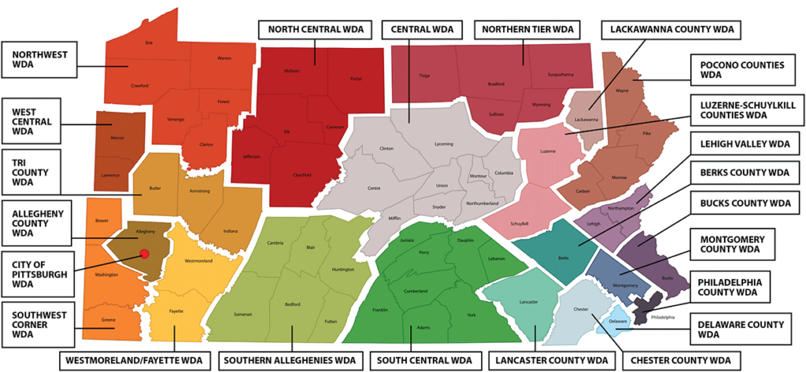
Overview of Local Workforce Development Area (LWDA) Plans
.
(PWDA, 2024)
Notes:
Purpose of LWDA Plans:
Tailored to meet the unique needs of each region
Alignment with local labor market demands and workforce needs
How LWDA Plans Support the State Plan:
Local flexibility within state guidelines
Cite from PWDA

Slide 9
Local Plan Focus Areas for Title II Adult Education Providers
Career pathways
English language acquisition
Apprenticeship and pre-apprenticeship
Out-of-school youth (OSY)
Barrier remediation
Reentry supports and services
Employer engagement
Notes:
Put in the chat:
What has worked over the last four years statewide, regionally, and locally that we want to see continue?
What is currently happening with local and regional planning?
What are some aspirations and opportunities for the next four years?
Opportunities around apprenticeships, OSY, barriers, and supporting employers.
Share a sample verbiage from a plan and ask people to notice and wonder -what do they notice that they might change, what are they wondering about/what is not clear-how might they change the section? (include some wording about drop outs and GED)Maybe do two examples like this and one include verbiage about English language learners and need minimal edits?
As an example of how XXXX is building career pathways and helping to expand training services to those with barriers to employment, we are partnering with a number of Adult Basic Education partners to push incumbent worker training. XXXX is also working closely with our Title II partners to help build a stronger, more integrated system to serve job seekers and adult learners. A part of this strategy is investing time and resources into a more cohesive plan to bolster co-enrollment levels between Title I and II. Based on discussions with Title II providers across the region, we know many customers qualify for Title I and II services but are not appropriately identified, referred to, and captured in shared data/outcomes. Implementing an effective solution for co-enrollment between Title I and II will require significant buy-in from all relevant partners. It is a major part of our local strategy in the coming years. XXXX has published a directive to all vendors requiring every participant to be assessed for basic literacy levels. Upon completing the assessment, participants are made fully aware of any literacy shortcoming; a document has been created as a companion to the ISS/IEP required documentation outlining the exact literacy grade level for the individual. The participant will sign off acknowledging understanding of the testing information and affirming their willingness to seek additional intervention with Title II. An XXXX case manager will make a formal referral to Title II services, including making an appointment on behalf of the participant.

Slide 10
Program Alignment to Workforce Development Initiatives
State workforce development board committees
Local workforce development board committees
Adult learner/jobseeker input
Public comment
Other ideas
Notes:
Ways to be involved in local plan- be on committee that supports the plan development, ask for draft prior to it being put out for public comment, gather learner (jobseeker) input to share with LWDA board, other ideas?
Is Title II described correctly and are correct services listed?
Does the terminology match state plan and other PDE guidelines? (high school equivalency, English language learner, GED® test, the HiSET®, etc…)
When Title II is mentioned specifically, is it clear what you are expected to do?
When Title II is not mentioned but could be supporting something that is mentioned, are you able to explain your role clearly to someone that is not familiar with Title II?
How is Title II included in pre-apprenticeship and apprenticeship initiatives?
How is Title II included in out-of-school youth initiatives?
How is Title II included in reentry services?
How are individuals with language barriers being supported in the local plan? Can you add additional recommendations?

Slide 11

Open Conversation
Notes:
Penne Watkins
Sharon Hagenberger
Challenges to providing input to the local plan

Slide 12
Call to Action
Regular communication and information-sharing
Collaborative service planning for adult learners
Joint workshops, events, and referral systems
Notes:
Past, present, future with partners-which partners will continue to be maintained as they are, which ones might need strengthening, where do gaps exist where new partnerships could help?
Mention WST course- Collaborative Service Delivery
Ask participants to identify an area they have the ability to control and make elicit change and share how they might take one small step or action towards change.
Effective Partnership Strategies:
Regular communication and information-sharing
Collaborative service planning for clients
Joint workshops, events, and referral systems
Ask participants to share some
Benefits of Collaboration:
Increased co-enrollment and resource sharing
Smoother transitions for clients between programs

Slide 13
Contact Information
Chrissie Klinger
Workforce Development Director
Email: cok5111@psu.edu
Loretta Lininger
Workforce Development Specialist
Email: lml160@psu.edu

Slide 14
References
U.S. Department of Labor. (2024). Workforce Innovation and Opportunity Act. https://www.congress.gov/113/bills/hr803/BILLS-113hr803enr.pdf
Pennsylvania Workforce Development Association (PWDA). (2024). Pennsylvania’s Local Workforce System. https://www.pawork.org/about/
Commonwealth of Pennsylvania. (2024). Regional & Local Plans. https://www.pa.gov/en/agencies/dli/programs-services/workforce-development-home/workforce-innovation-and-opportunity-act.html
Commonwealth of Pennsylvania. (2024). 2020-2024 Pennsylvania WIOA Combined State Plan Modification. https://www.pa.gov/content/dam/copapwp-pagov/en/dli/documents/businesses/workforce-development/grants/documents/2020-wioa-state-plan.pdf
Commonwealth of Pennsylvania. (2024). 2024-2028 Pennsylvania WIOA Combined State Plan Modification. https://www.pa.gov/content/dam/copapwp-pagov/en/dli/documents/businesses/workforce-development/grants/documents/pa%20wioa%20combined%20state%20plan%202024-2028%20draft.pdf

