Slide 1
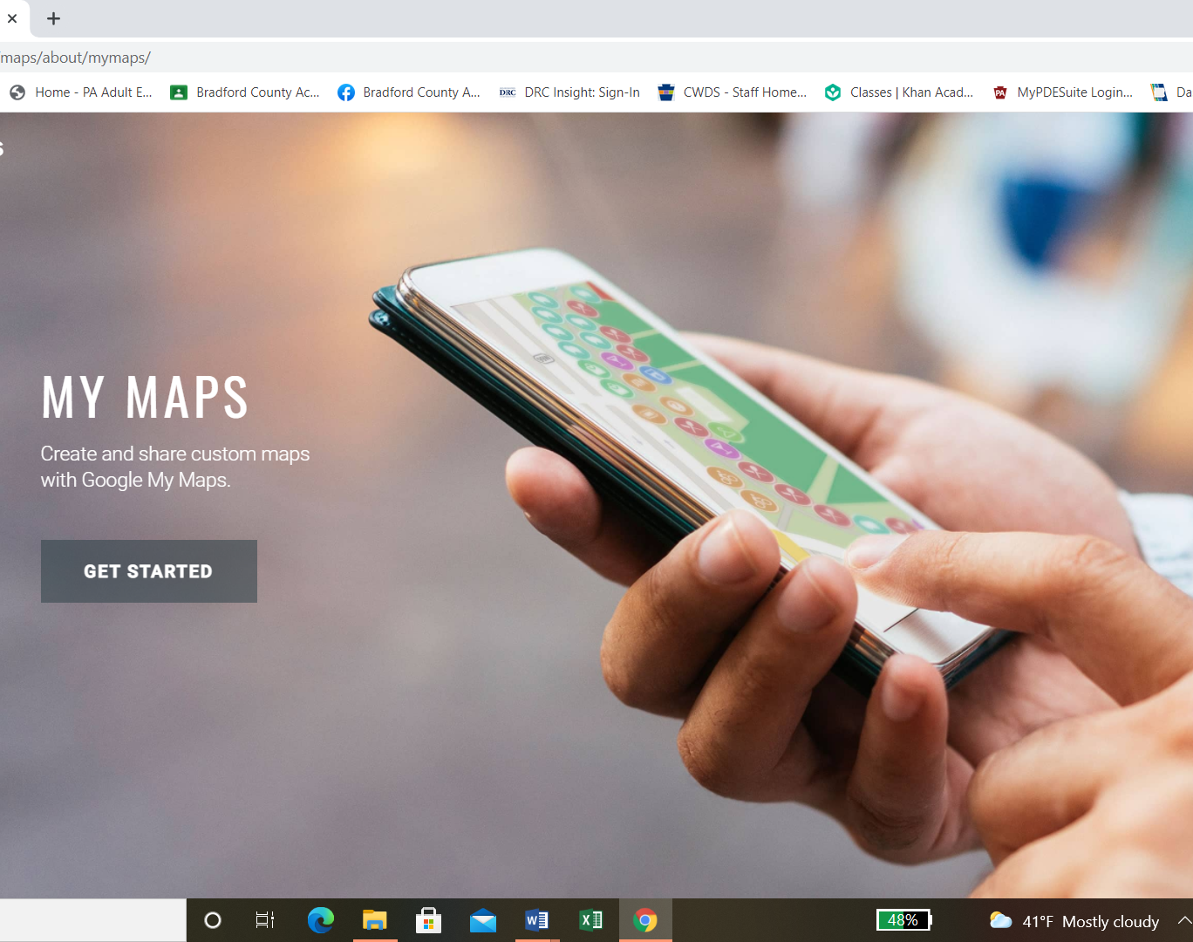
Using My Maps
When you open My Maps/Google this is what the first screen should look like. Click on GET STARTED.

Slide 2
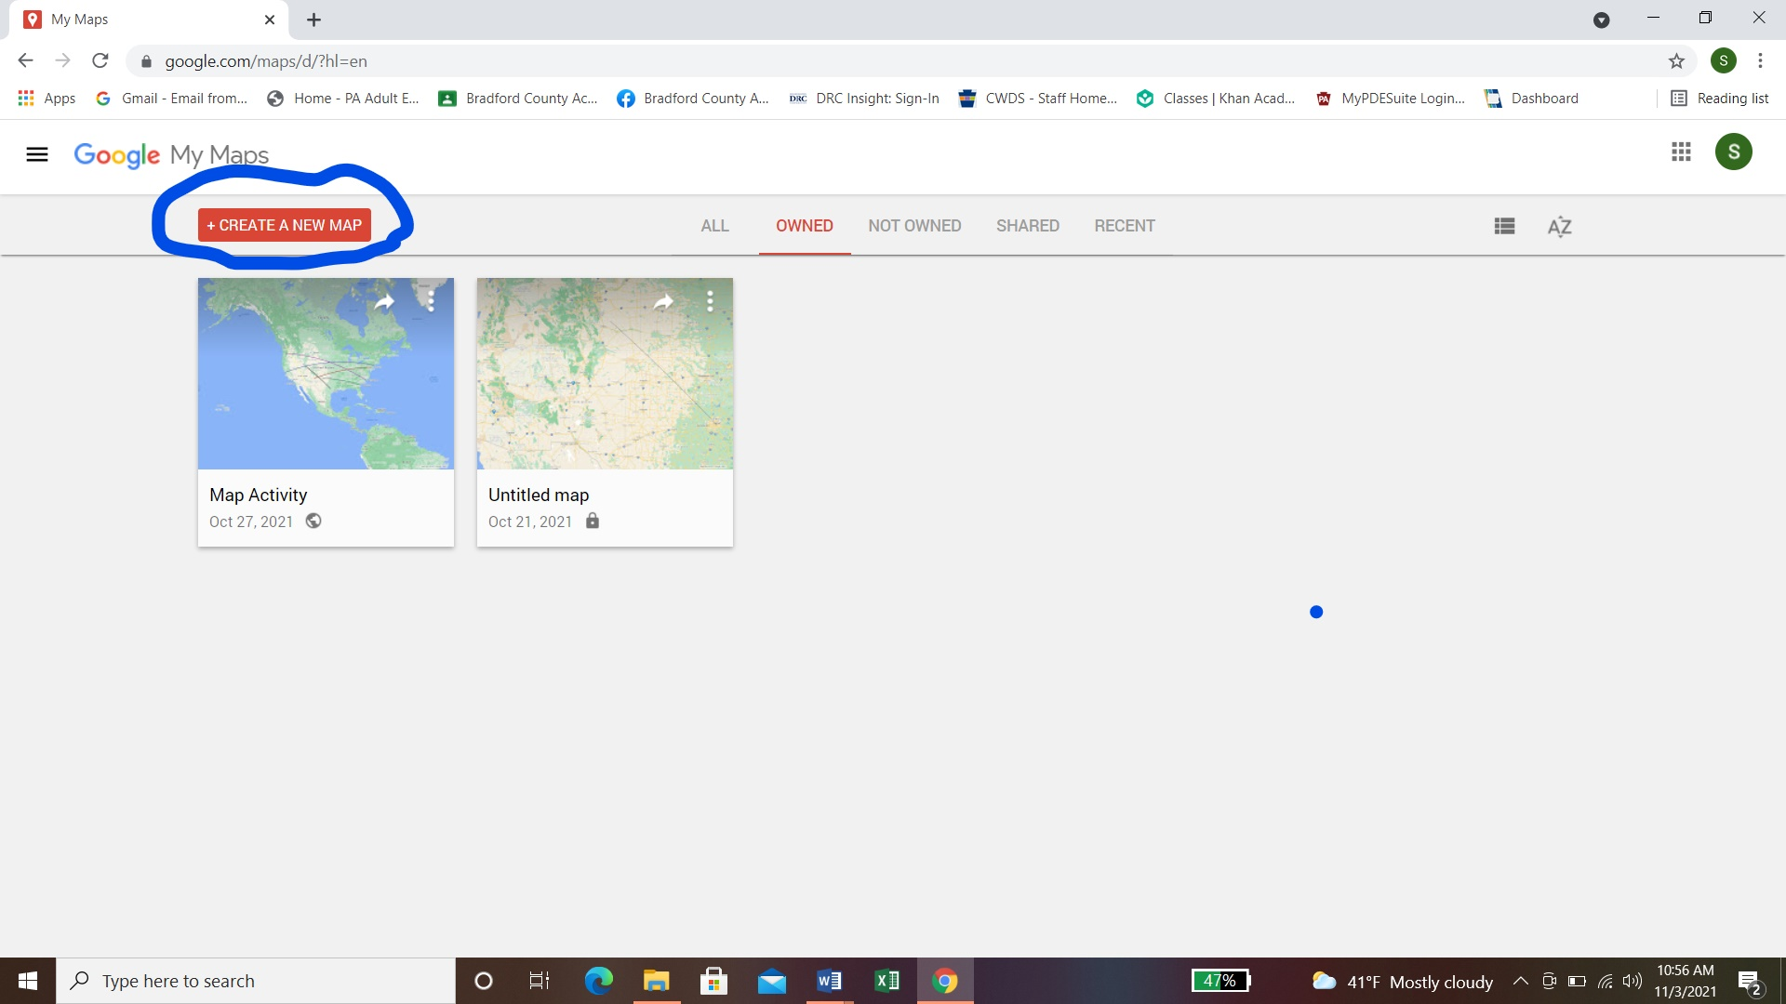
Create a New Map
Click on create new map to start a new map to create your trips.

Slide 3
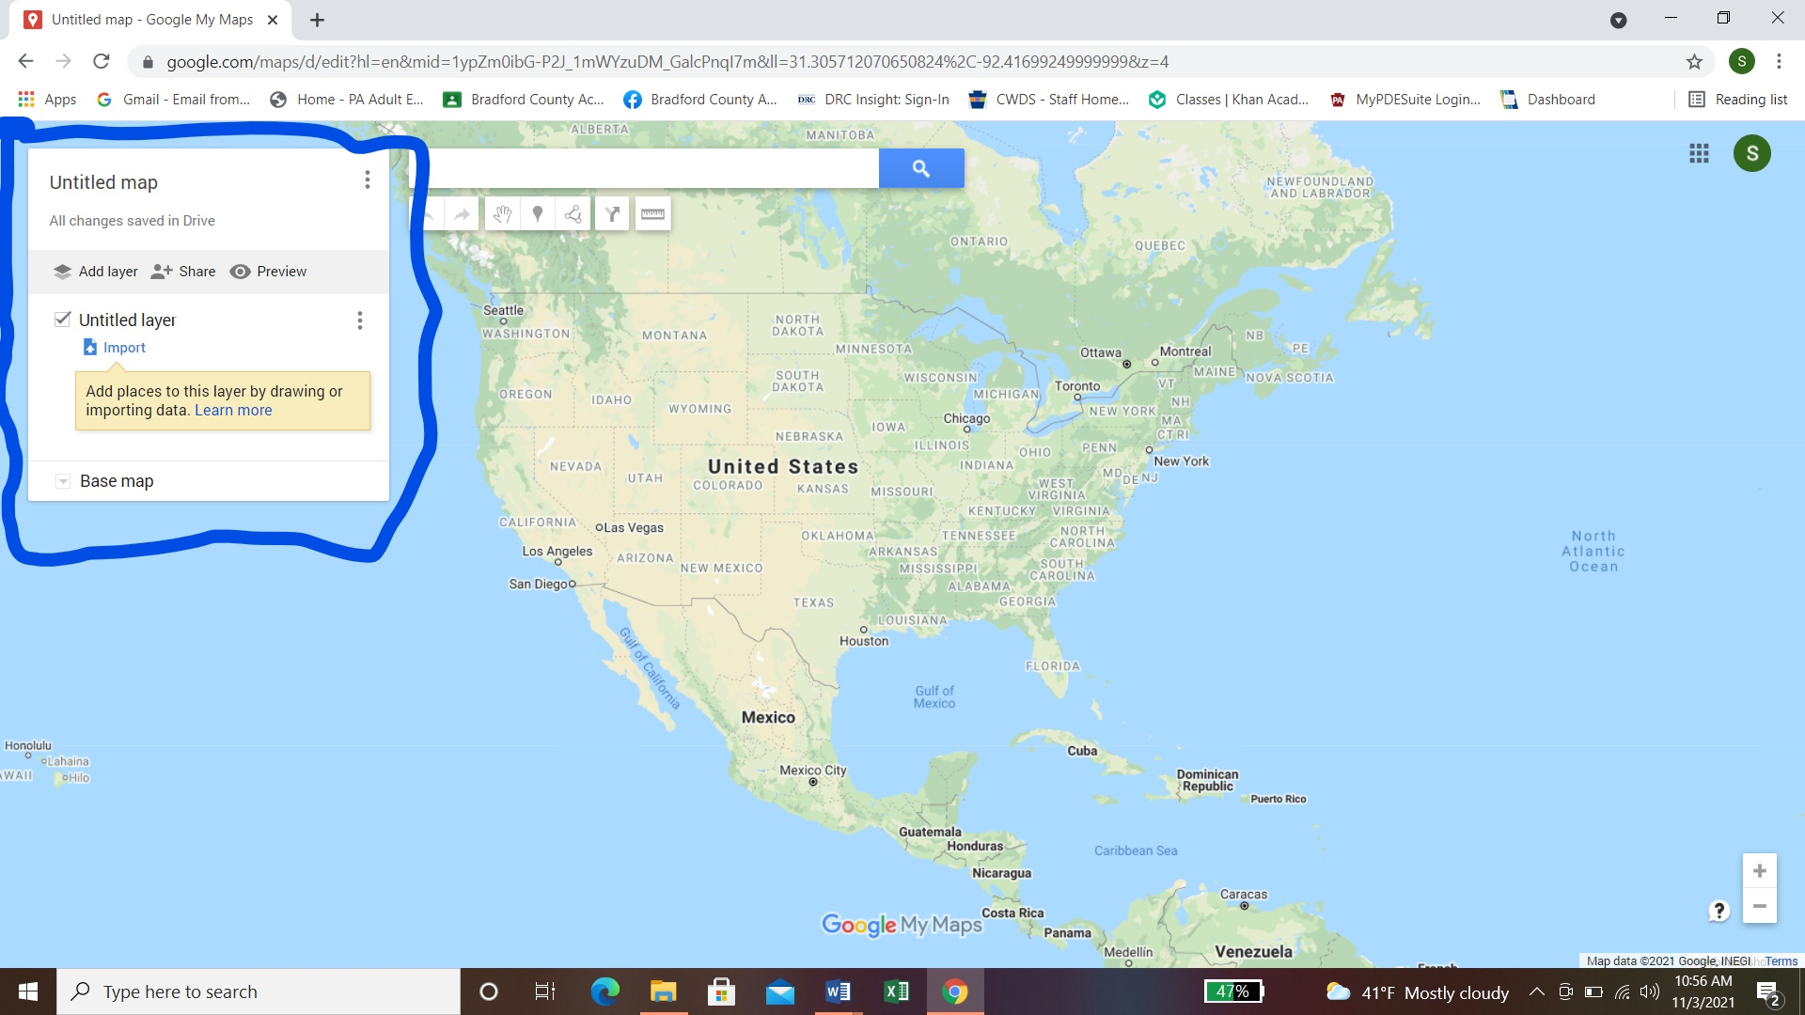
Using layers
You can use the untitled layers to name your trips.

Slide 4
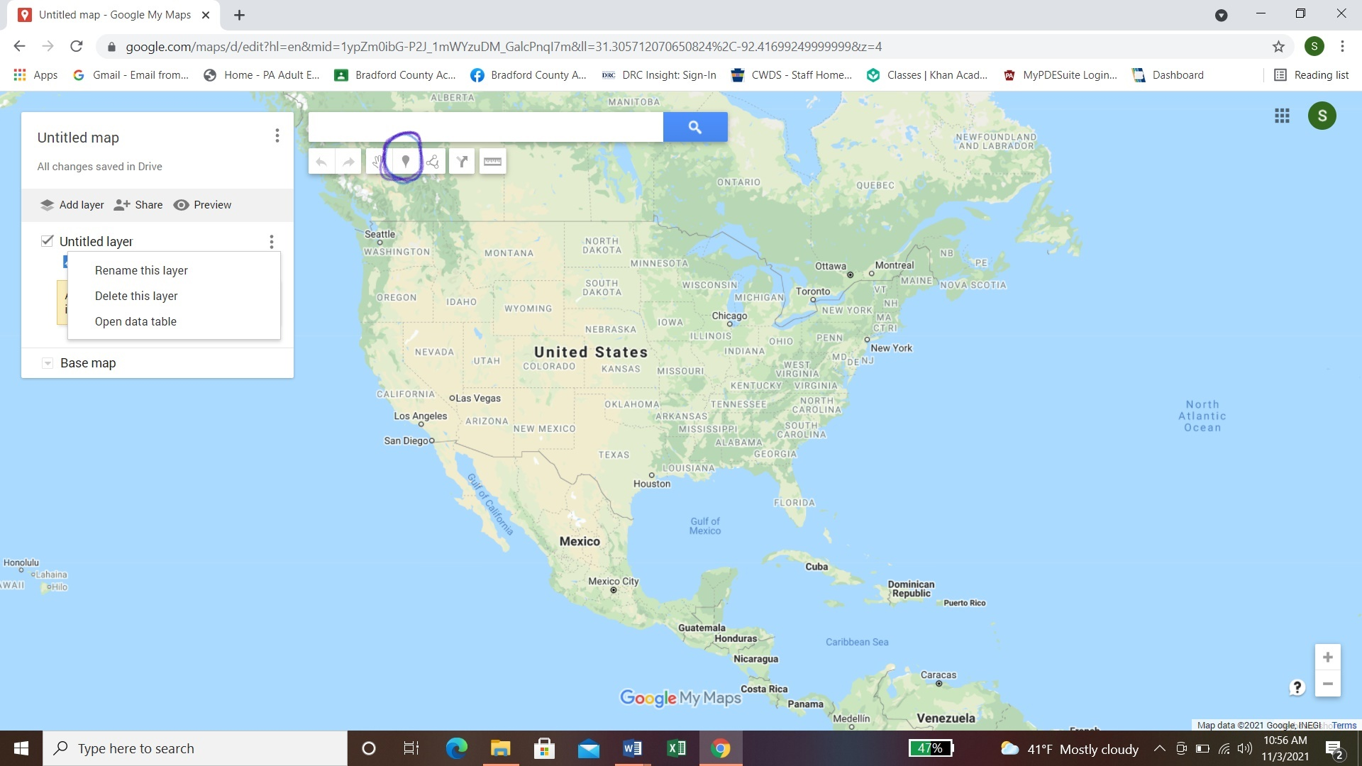
Pin Your Location
The icon circled in blue is used to pin your locations.

Slide 5
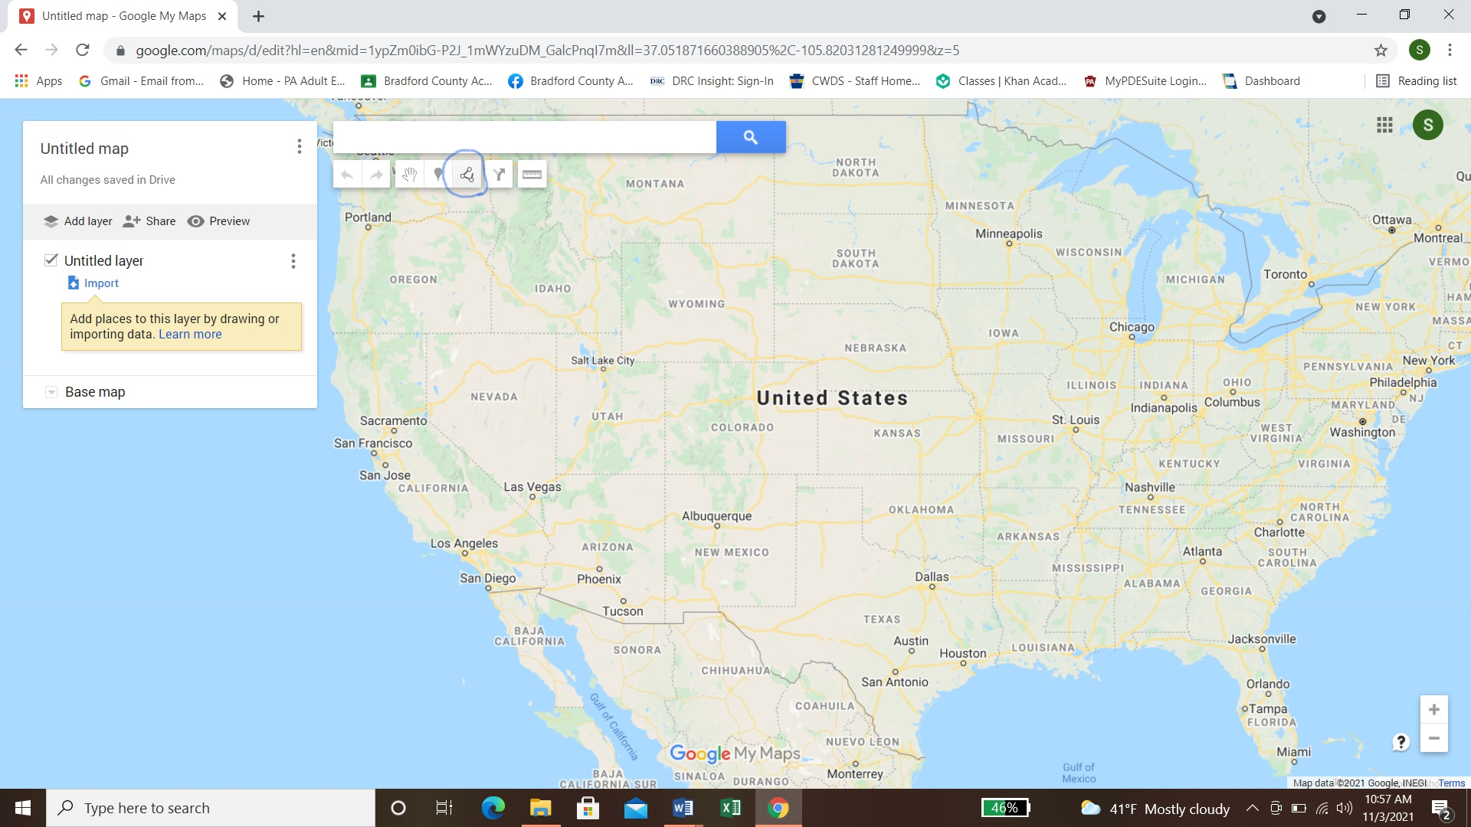
Draw Lines
The icon circled in blue is used to draw lines from one location to another. You can edit the color of each line. Once you have started drawing a line, double click to stop using the line tool.

Slide 6

Use the Ruler
The icon circled in blue is the ruler tool. Click on the ruler then click on a location and drag with your mouse to the next location and it will show distance. Once you have started using the ruler, double click to stop using it.

Slide 7
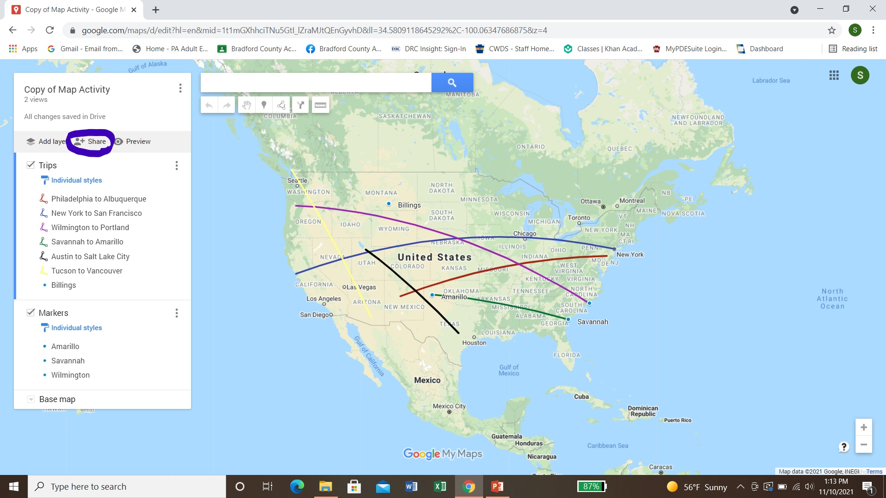
Share Your Map
You can use the share tool to email your finished map to your instructor.

